Slide 1
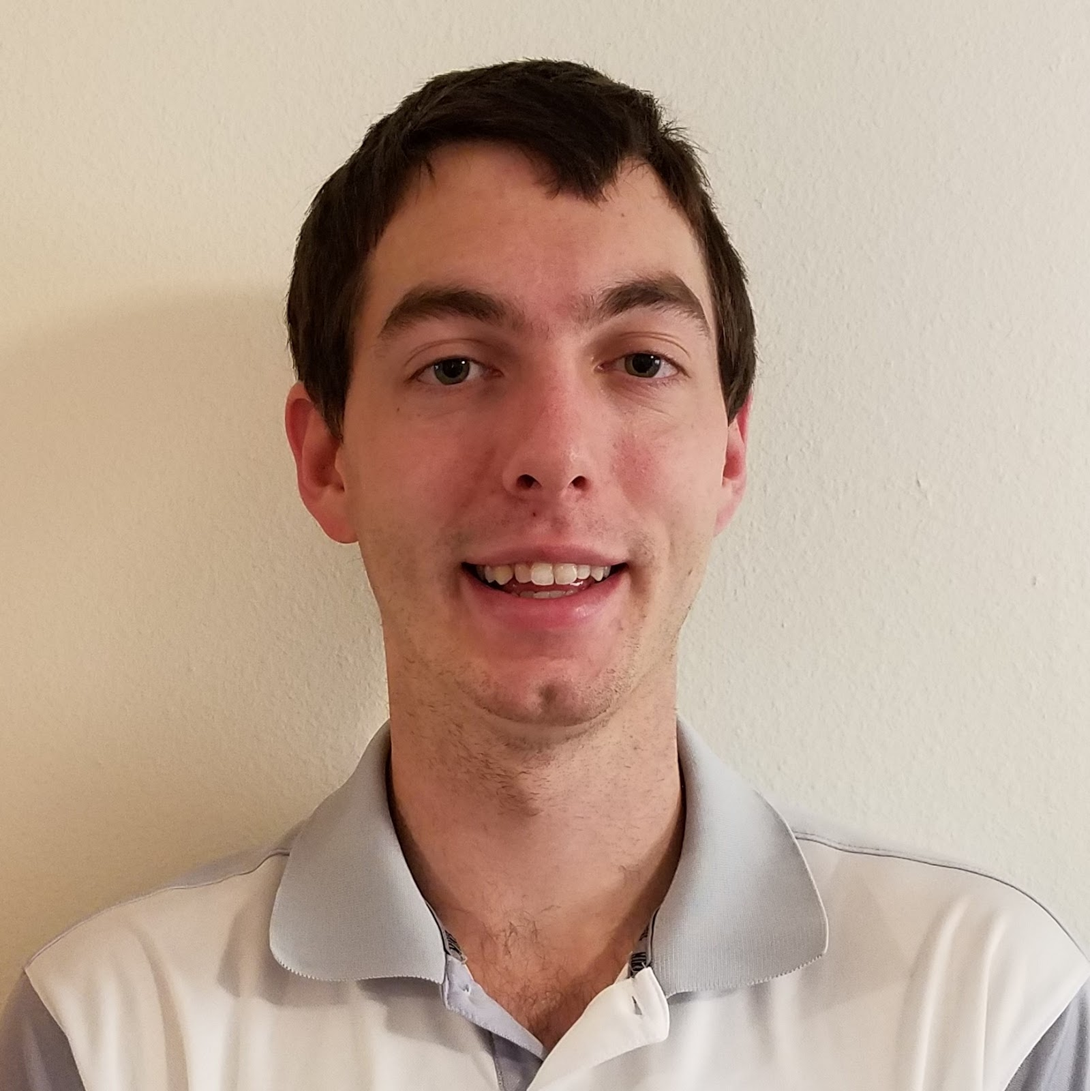
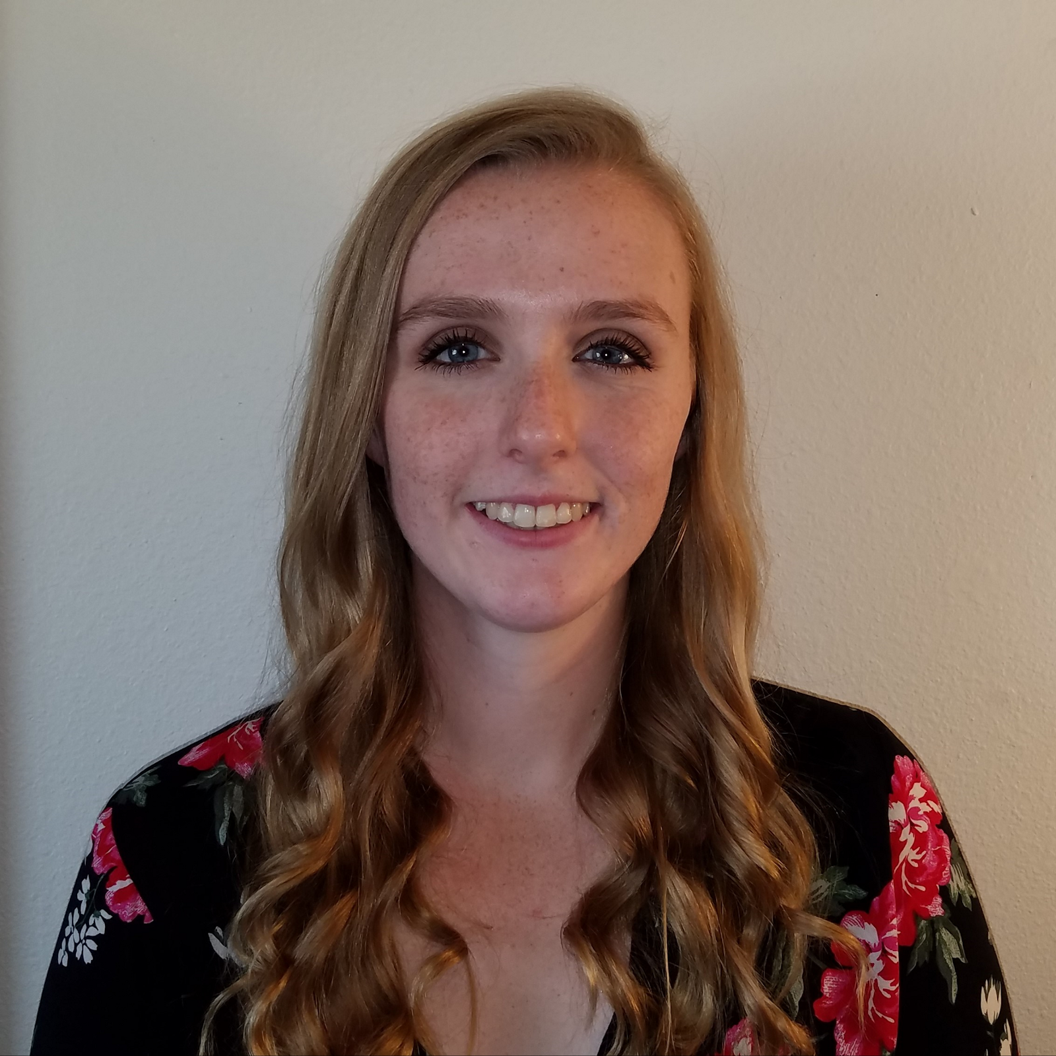

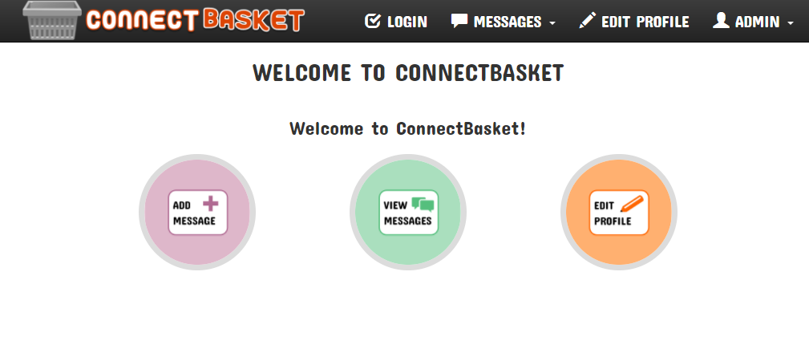
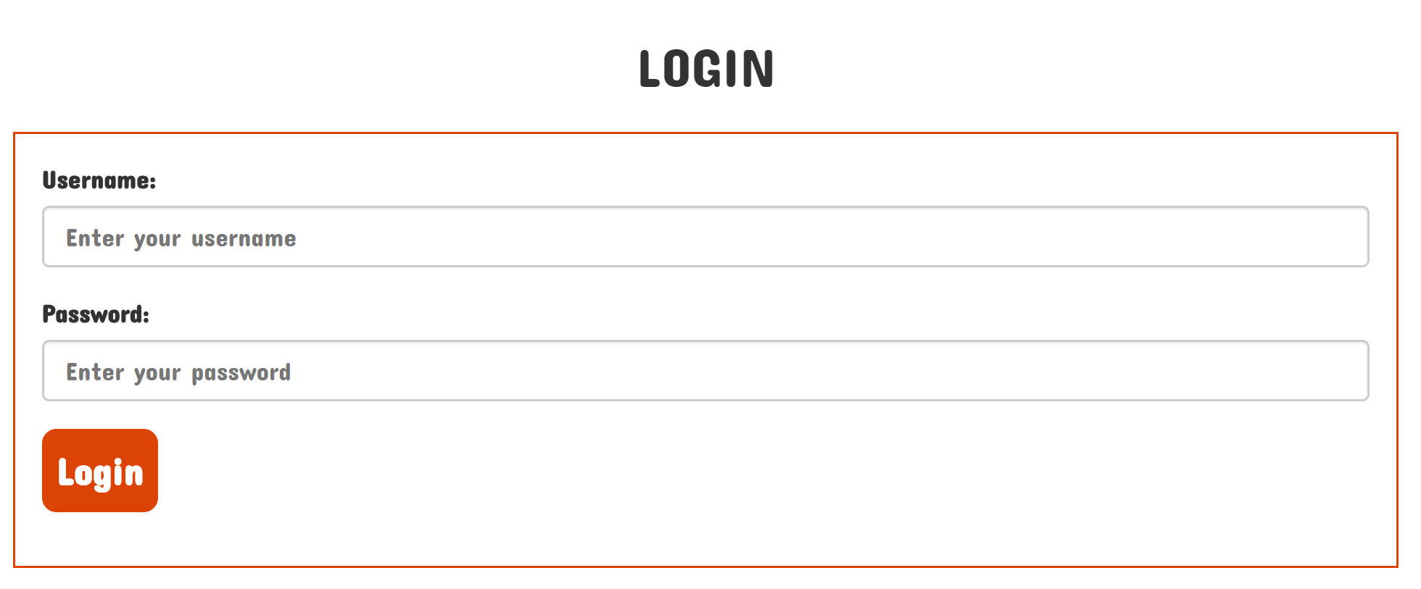
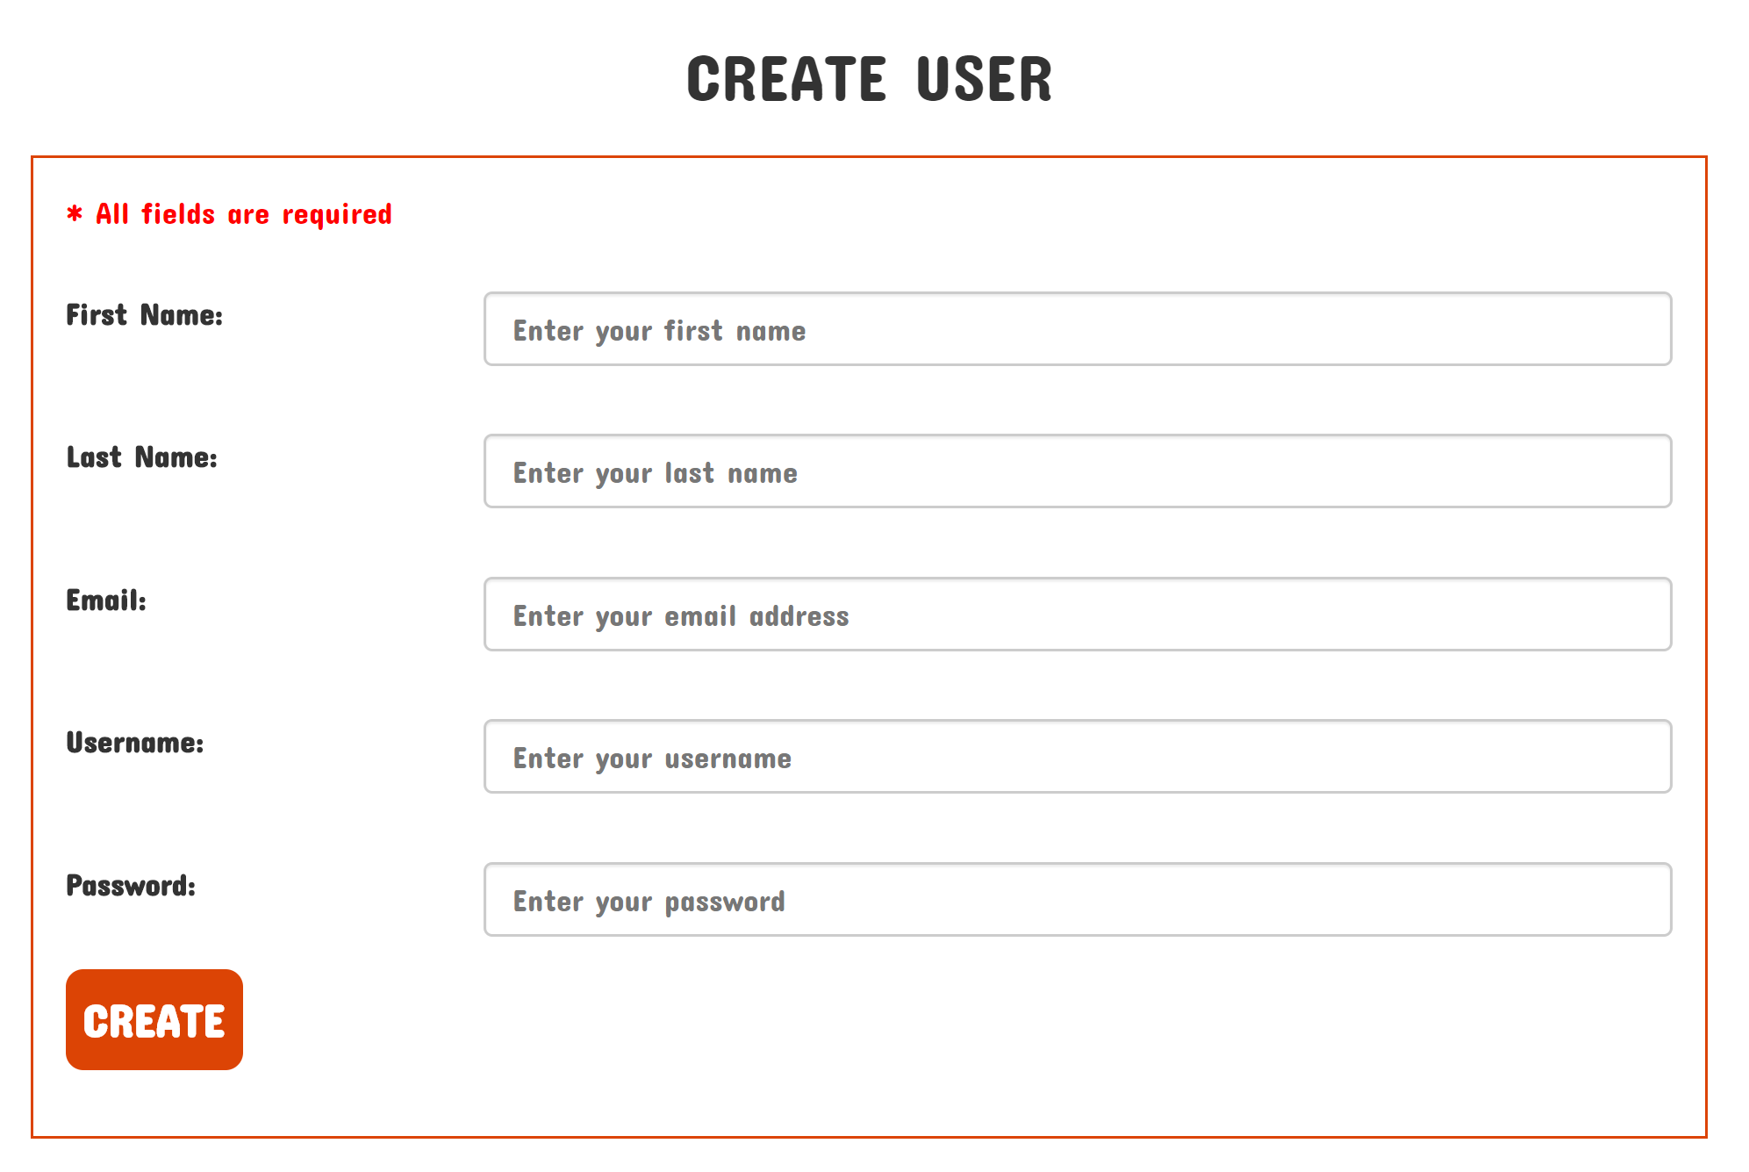
###
Connectbasket
Introduction and background
Software to help improve pet care at the OSU Veterinary Hospital by streamlining internal hospital communication
Having an efficient and easy-to-use software system for managing operations is integral for any company, and the Oregon State University Veterinary Hospital is no exception. The current software used by the hospital to manage their daily operations is decades old and doesn’t allow efficient communication within the hospital. This software causes many unnecessary errors and patient and owner suffering that could be avoided with a better system. The hospital needs a new software package that will not only provide a system that doesn’t hinder workflow, but will improve it and allow for increased efficiency.
Pictured from left to right: Henry Fowler, Kailyn Hellwege, Taylor Kirkpatrick
Project client: Dr. Eseonu
Affiliation: Oregon State University Veterinary Hospital
Insert Vet Hospital Logo
Contact Information:
fowlerh@oregonstate.edu
hellwegk@oregonstate.edu
kirkpatt@oregonstate.edu
REsults
Project goals
Allow users to create a message which will be associated with a patient and corresponding owner
Allow messages to have a status to tell whether they are open or closed
Allow messages to be routed to other users or groups of users
Allow notes to be added to messages
Allow users to have profiles where they can select or change their group membership
Provide an audit log of all messages created over a given time period
Increase the overall efficiency of messages being transported throughout the hospital
Reduce the amount of paper being printed
Reduce errors in the communication process of the hospital
Users must log in to access the system
Project description
Project outcomes
In order to accomplish the goals of this project, the ConnectBasket website was created. The website provides a platform for hospital employees to log in and access several features such as creating, editing, and viewing messages for specific pets and owners.
The website is hosted using an Apache web server running on a Linux Ubuntu server operating system. The data for our website is stored in a MySQL database and PHP was used for interaction between the website and the database. The front end of our website was made using the AngularJS framework along with HTML and CSS.
We chose to create a website for our project because the users wanted to be able to access the project from desktop computers and mobile devices, and a website was the best way provide that in the time available for the project.
Using a website will decrease the amount of paper that is printed at the veterinary hospital.
Efficiency of taking messages from pet owners is increased with the new system.
Having access from mobile devices allows employees to be quicker in responding to messages providing faster and better care for pets.
Administrators can create new users and give them access to the system

